Slide 1
Creational Patterns
Factory and Abstract Factory

Slide 2
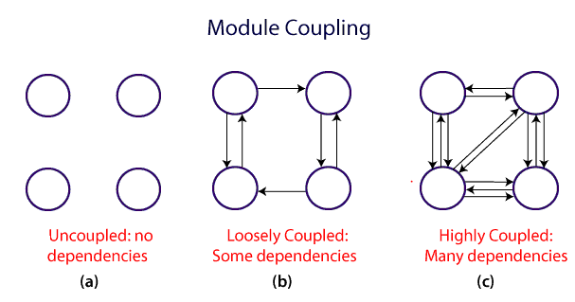
Coupling and Cohesion in OOP
Coupling is the degree of interdependence between software modules
Two modules that are tightly coupled are strongly dependent on each other.
Two modules that are loosely coupled are not dependent on each other.
Uncoupled modules have no interdependence at all within them.

Slide 3
Coupling and Cohesion in OOP
A good design is the one that has low coupling.
Coupling is measured by the number of relations between the modules.
The coupling increases as the number of calls between modules increase or the amount of shared data is large.
It can be said that a design with high coupling will have more errors.

Slide 4
Coupling and Cohesion in OOP
Cohesion defines to the degree to which the elements of a module belong together.
Cohesion measures the strength of relationships between pieces of functionality within a given module.
In highly cohesive systems, functionality is strongly related.

Slide 5
Factory Pattern
is a Creational Pattern
create object without exposing the creation logic to the client and refer to newly created object using a common interface.
factories handle the details of object creation
program to interfaces not implementations
also known as Virtual Constructor

Slide 6
Factory Pattern
Problem
instantiation is an activity that shouldn’t always be done in public and can often lead to coupling problems.

Slide 7
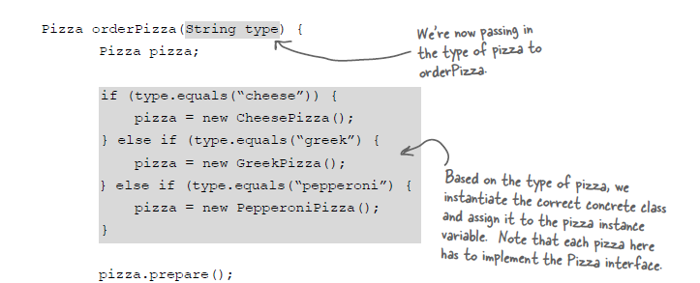
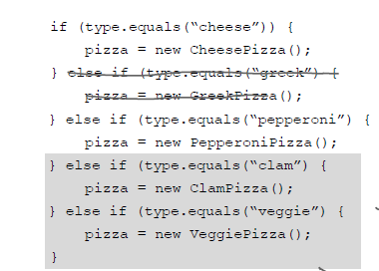
Factory Pattern

Slide 8
Factory Pattern
Solution
Create a pizza factory

Slide 9

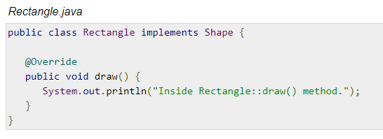
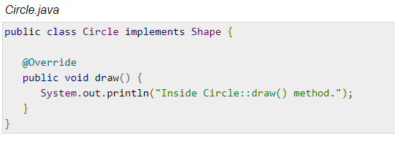
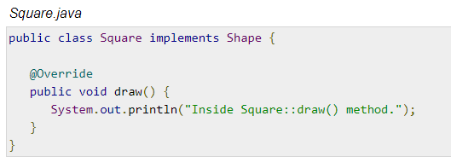
Factory Pattern

Slide 10
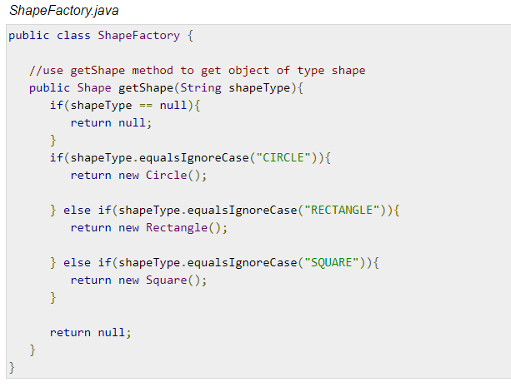
Factory Pattern

Slide 11
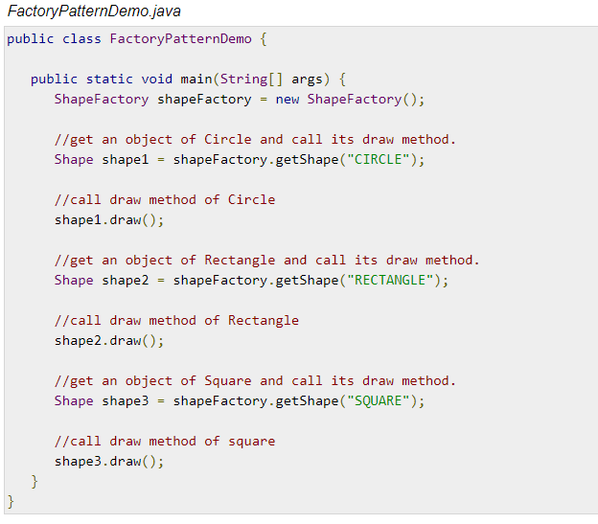
Factory Pattern

Slide 12
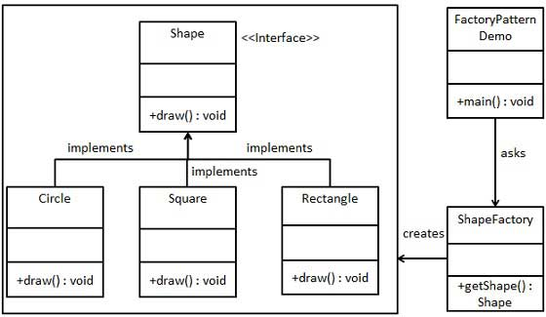
UML diagram of Factory Method

Slide 13
Abstract Factory
Abstract Factory patterns work around a super-factory which creates other factories. This factory is also called as factory of factories.
an interface is responsible for creating a factory

Slide 14
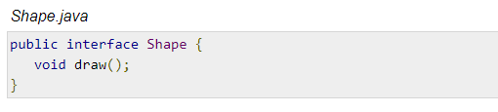
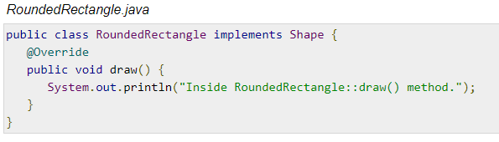
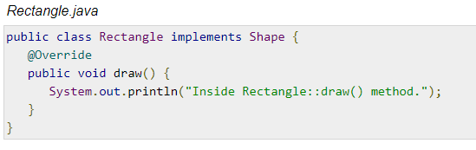
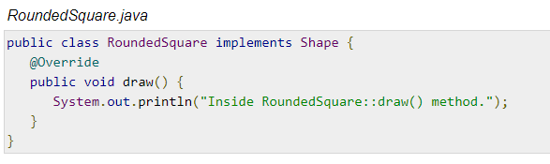
Abstract Factory

Slide 15
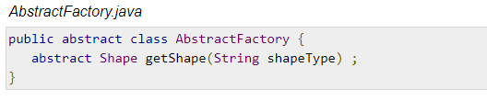
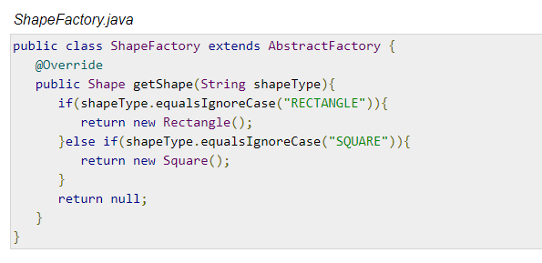
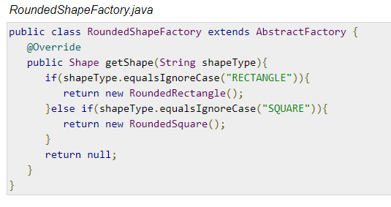
Abstract Factory

Slide 16
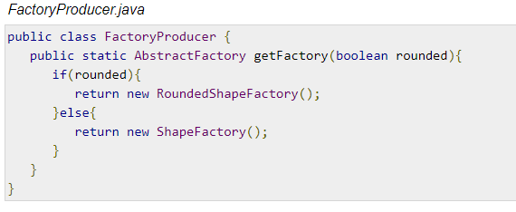
Abstract Factory

Slide 17
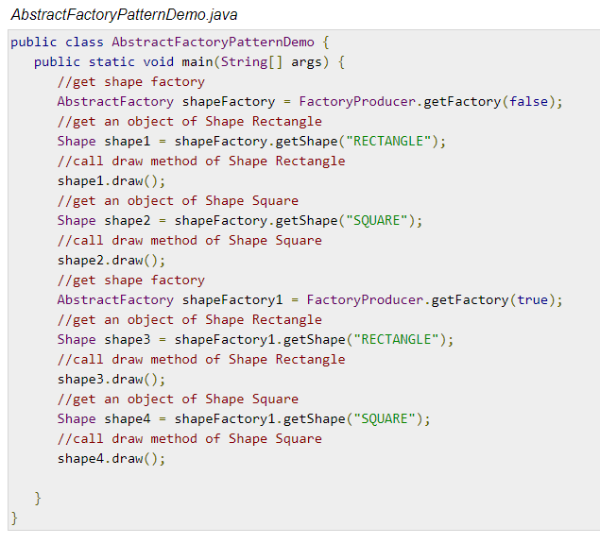
Abstract Factory

Slide 18
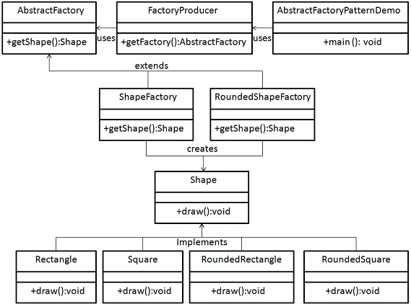
UML Diagram of Abstract Factory

